Slide 1


Faculty of Engineering Tanta University
Department
Computer and Automatic Control Engineering
A Graduation Project Entitled
Water treatment plant automation using PLC and SCADA
Fourth Year, 2023

Slide 2
Contents
Introduction
Our representation of the system
Electrical components
Software
ATS
Conclusion
Future updates

Slide 3
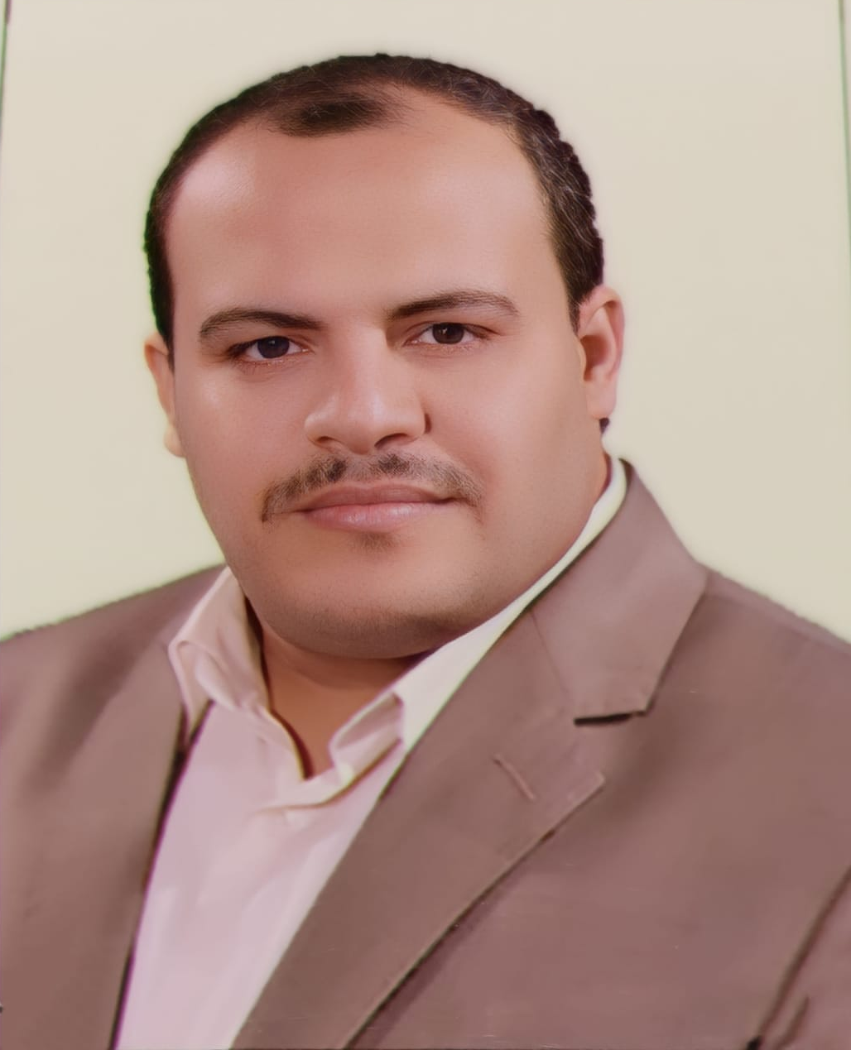
under the Supervision of
Assoc.Prof.Dr / Mohammed Arafa Al-Badry

Slide 4





Team members

Slide 5
Team members

Slide 6
Team introduction
Mohammed Darwish

Slide 7
Team members
Abanoub Ashraf

Slide 8
Team members
Abdallah Abd El-Razik

Slide 9
Team members
Mostafa Arafat

Slide 10
Team introduction
Tasbih Ahmed

Slide 11
Team members

Slide 12
Team introduction

Slide 13
Introduction
The efficient management of our world's precious water resources is crucial for progress. Programmable Logic Controllers (PLCs) have emerged as a vital tool in water treatment plants, combining intelligence and automation to maintain the delicate balance of purity and sustainability. With their unmatched precision and control, PLCs revolutionize water treatment processes, embodying the relentless pursuit of excellence in ensuring the story of life unfolds in every drop of water.

Slide 14
Project spotlight
Our project combines physical and software elements to faithfully recreate water purification complexity and provide an immersive learning experience.

Slide 15
How is water purified?
Flash mixer
الخلط السريع
Coagulation
الترويب
Pump Ward
عنبر الطلمبات
Screening التصفية
Flocculation
التنديف
Sedimentation
الترسيبب
Filters
الفلترة / المرشح
Chlorination
الكلورة (التعقيم)

Slide 16
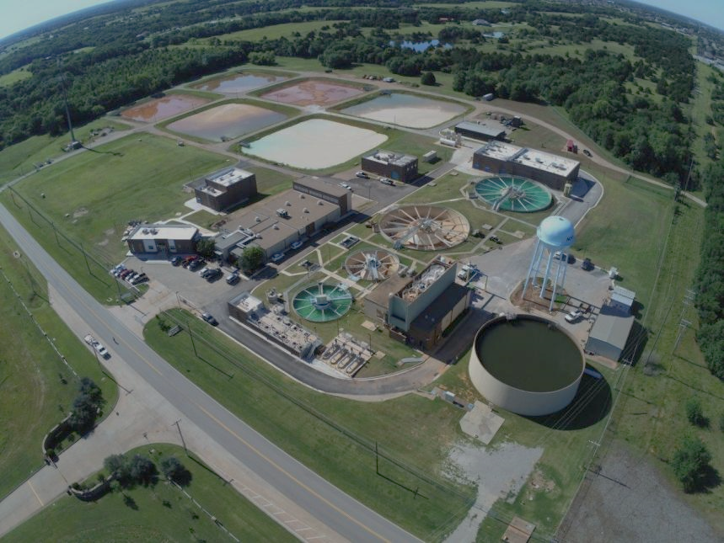
Our representation of the system
We simply implemented the phases of the plant in our own way the shows how water is usually treated.
Our main reference was real plants and water purification books that illustrated the methodologies of crafting a water treatment plant.

Slide 17
Water intake
Water intakes in real treatment plants could be divided into two main parts:
The first one is the source water that needs treatment.
That water goes through screening before it enters the raw water containment.
The second part is the raw water pumps hall where raw water is propelled through the entire plant.

Slide 18
Water intake
We simulated the intake by simply using a tank as a representation of the raw water containment.
For the second counter part we utilized a 10-watt water pump that is more than enough to propel water throughout the replica.
We also used a sensor that detects the entry of water in order to protect the pump and alarm the user of the system of the lack of water in the inlet tank.

Slide 19
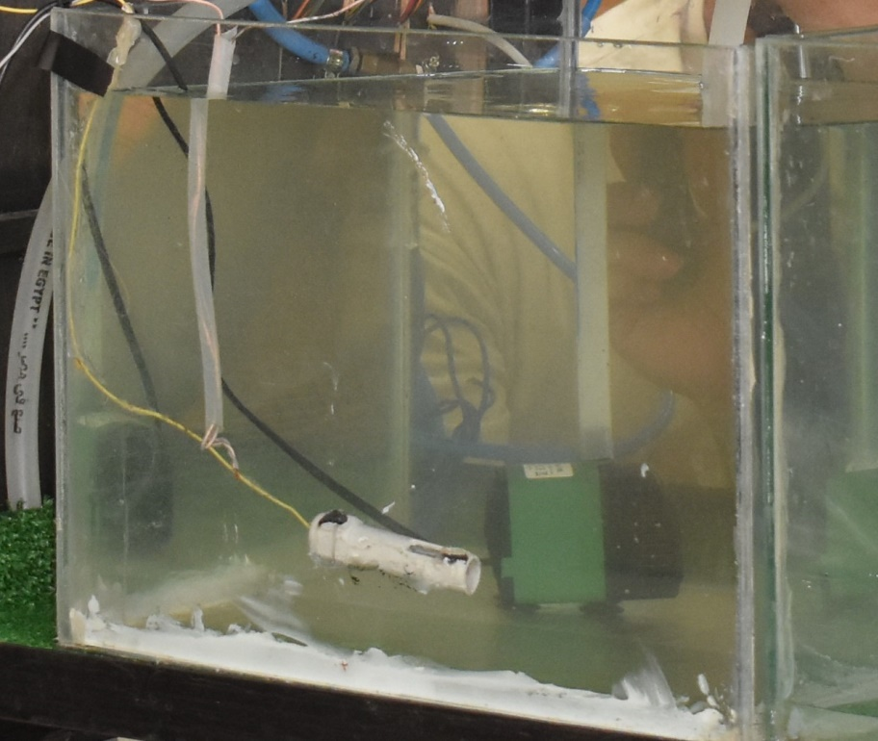
Intake tank

Slide 20
Chemical injections
When the water is propelled through the pipes on its way to the flash mixer a specified amount of chlorine is injected into the pipes, and it takes around 15-30 seconds after the injection of chlorine and before reaching the mixing phase.
Chlorine is added in order to eliminate living organisms like parasites or planktons.
The second injection is Alum which is used to catch non-living objects like dust and its sorts
The alum has positive and negative ions that attracts and merges with all sorts of non-living unneeded objects.

Slide 21
Chemical injections
In order to replicate the injection idea, we used hanging infusion bags for both chlorine and Alum.
The Alum and chlorine injection is controlled by liquid valves, so we could easily stop the injection when needed.
The injection process was made in the same order as a real treatment plant, since that the chlorine injection process takes around 6-8 seconds before it reaches the next phase.

Slide 22
Flocculation
The flash mixing: it is mixing the flocculant materials with raw water to create a uniform distribution of the flocculent material (alum) through the water, and this process takes place within seconds.
If that process is longer than a couple of seconds, the flocculants would break again separating the Alum from the objects it was once stuck to.

Slide 23
Flocculation
Imitation of the flocculation process was created using a glass tank as the water container and an actuator that acts as the mixer that Stirs the flocculant materials in the water and a water detection sensor that indicates the existence of water in the tank to start the actuator.
The water enters the tank from below and continues rising until it reaches the top of the tank, and it flows through a specially designed conduit that is connected to a pipe that delivers the water to the next phase.

Slide 24
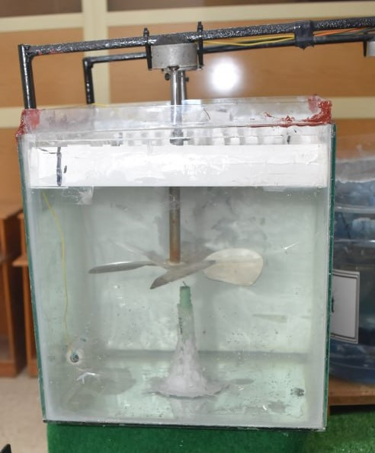
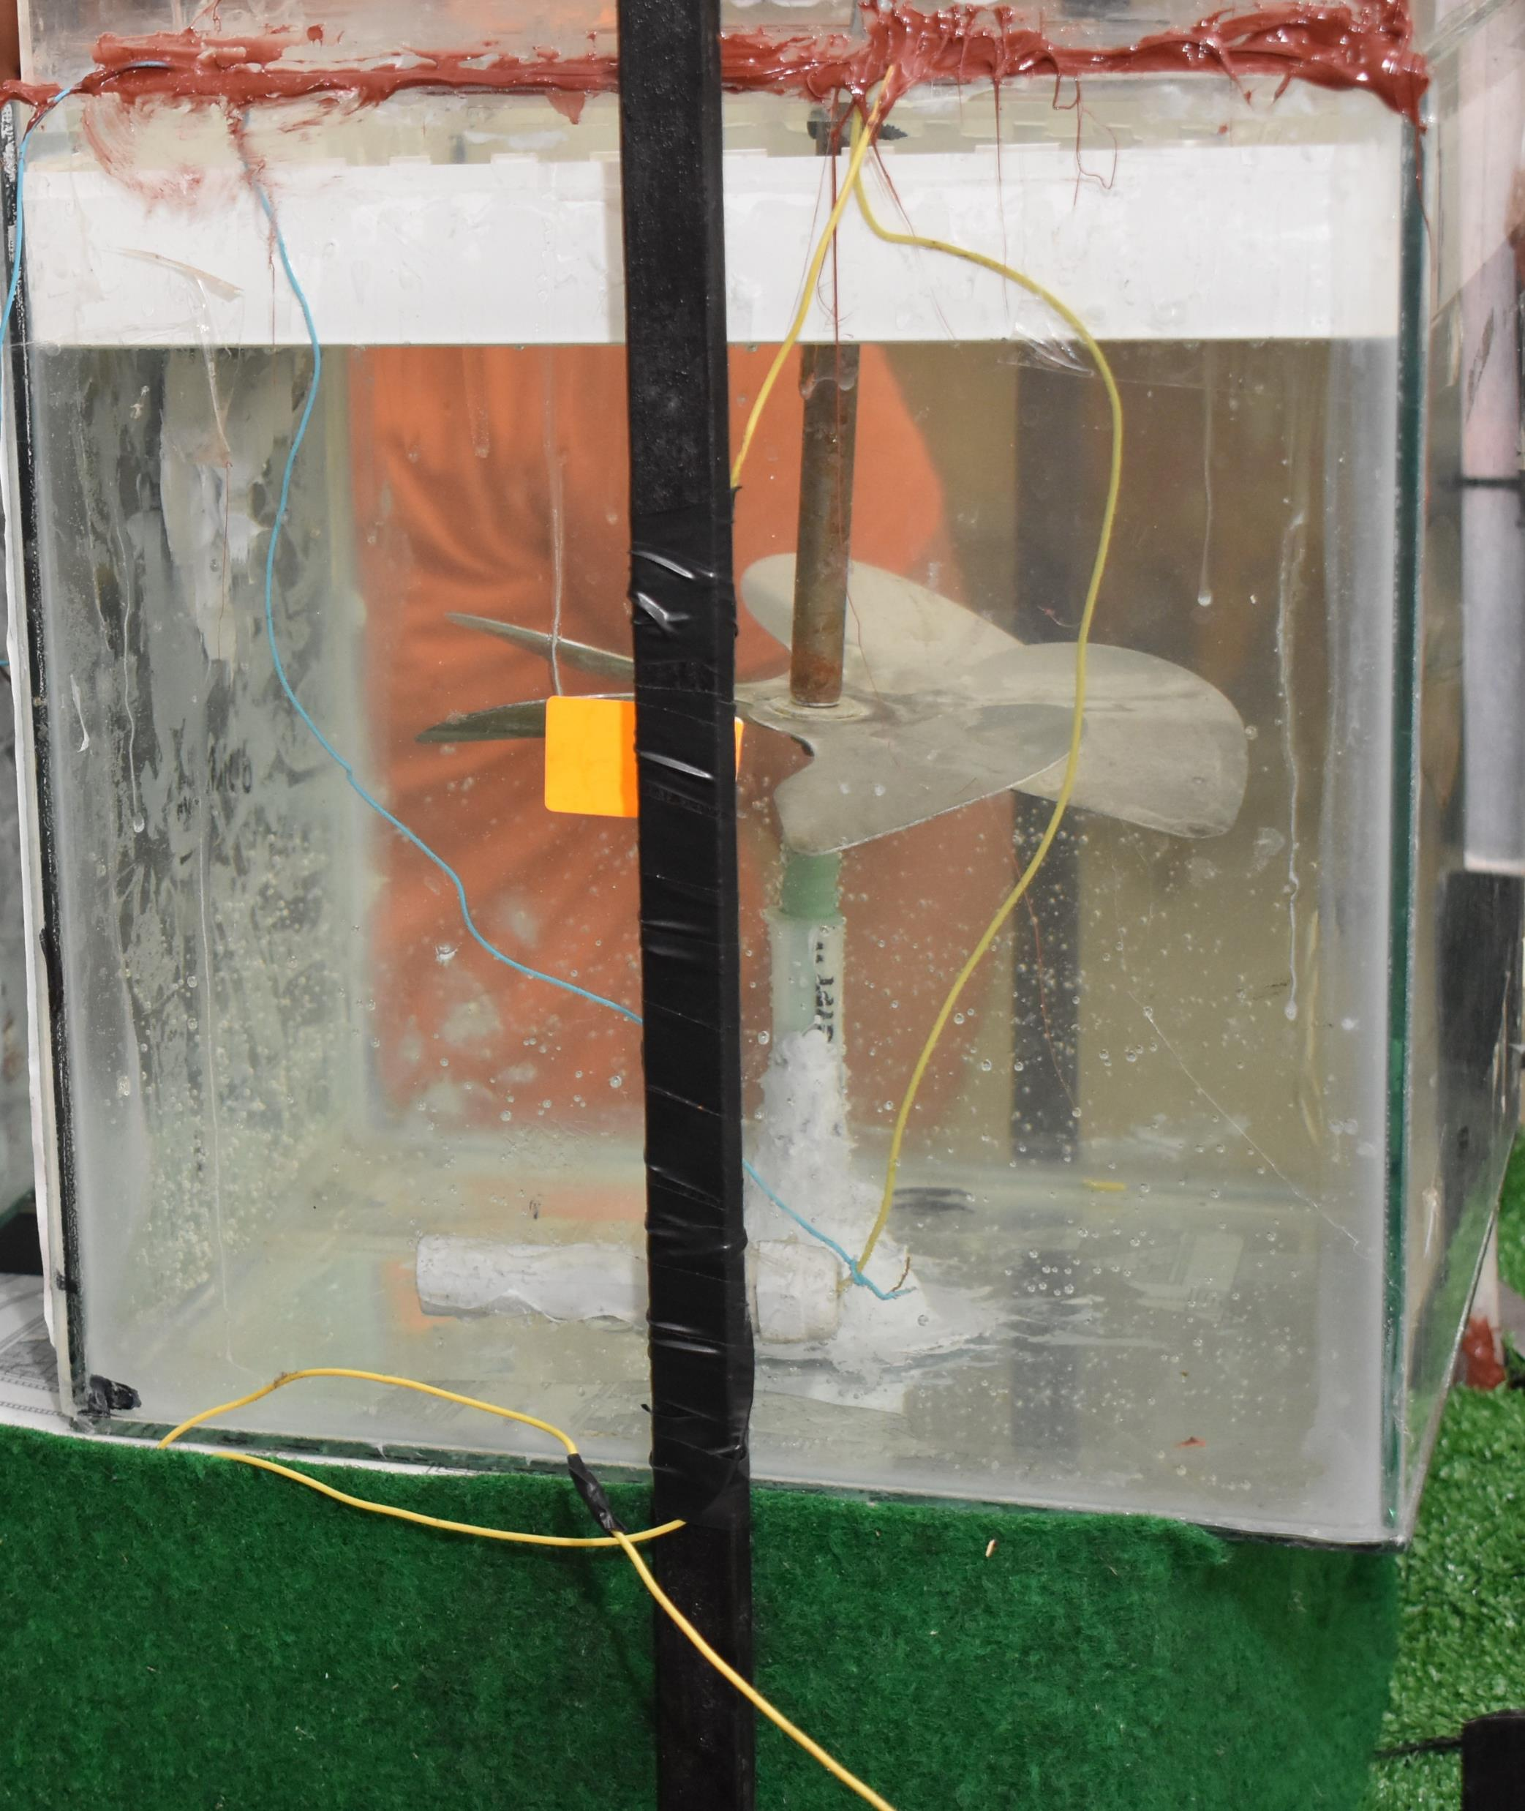
Flash mixer tank

Slide 25
Coagulation and Sedimentation
Coagulation takes some time and needs slow mixing to be achieved. Due to the existence of Alum coagulant material is formed and precipitated in the bottom of the basin that later is driven to the sludge.
Sedimentation: The sedimentation process is known in the stages of treatment and purification of drinking water as the main procedure for the sedimentation of materials and plankton from the water and the preparation of water to enter the next stage, which is the filtration process.
Usually that basin operates about 15 minutes every 2 hours of the plants operation.

Slide 26
Coagulation
Coagulation is represented in our replica in by using a glass tank in lower plane than the previous tank so that water would flow smoothly to it.
The tank contains a slow mixer for the coagulation process and a water detection sensor to start the actuator when water is detected in the tank.
The tank is filled from below just like the previous one but the delivery to the next phase is different.

Slide 27
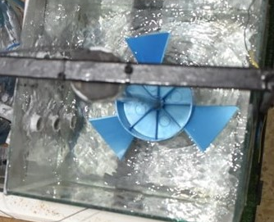
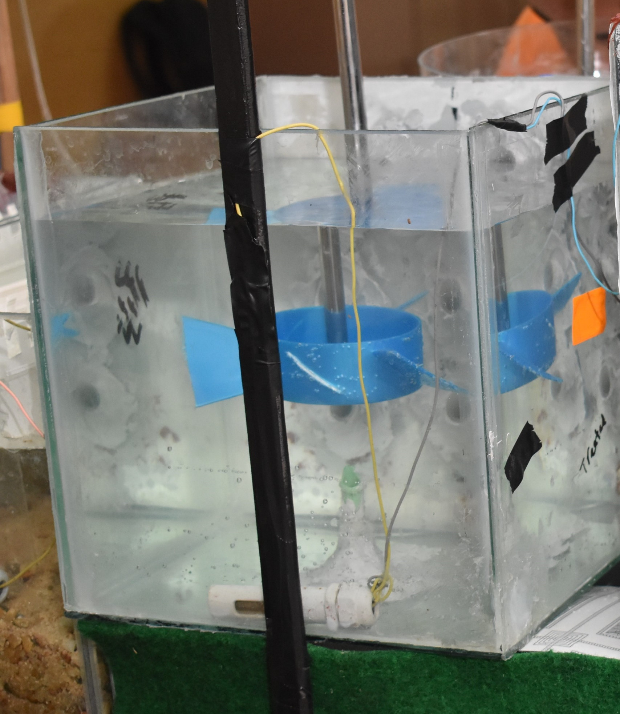
Slow mixer

Slide 28
Sedimentation
Through six parallel tubes the water is driven to the sedimentation tank that contains an actuator that operates when needed to drive sediments to the sludge at a specified time, so that tank contains a water valve the opens when needed to deliver the sediments to the sludge.
The tank also contains a water detection sensor to perform the same function as the previous two sensors.

Slide 29
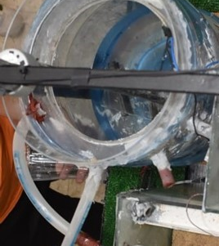
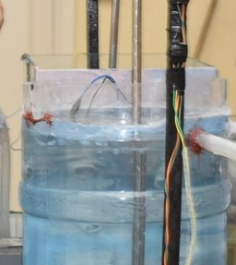
Clarifier

Slide 30
Filtration
The water filtration process is defined as the procedure that takes place to completely rid the water of plankton, bacteria, and algae.
It simply depends on blocking any remnants that might be in the water in order to deliver the clearest possible outcome of the purification process.
Usually, those filter basins get blocked by the remnants of the water or the dust in the air around the filters since that they are usually exposed, thus washing those filters every 8 or 12 hours is necessary.

Slide 31
Filtration
The filters in our project are made of glass tanks that were specially designed to handle filtering the water and washing the tank itself when it is blocked by sediment. We deployed two filters so that if one filter is being washed the other one would be working naturally parallel to each other.
Starting with the bottom of the filter where we deployed two perforate conduits one of them supplies air and the other supplies water.
Right above those two conduits we put two PVC shelter-like blocks that would protect the conduits from any solid materials.

Slide 32
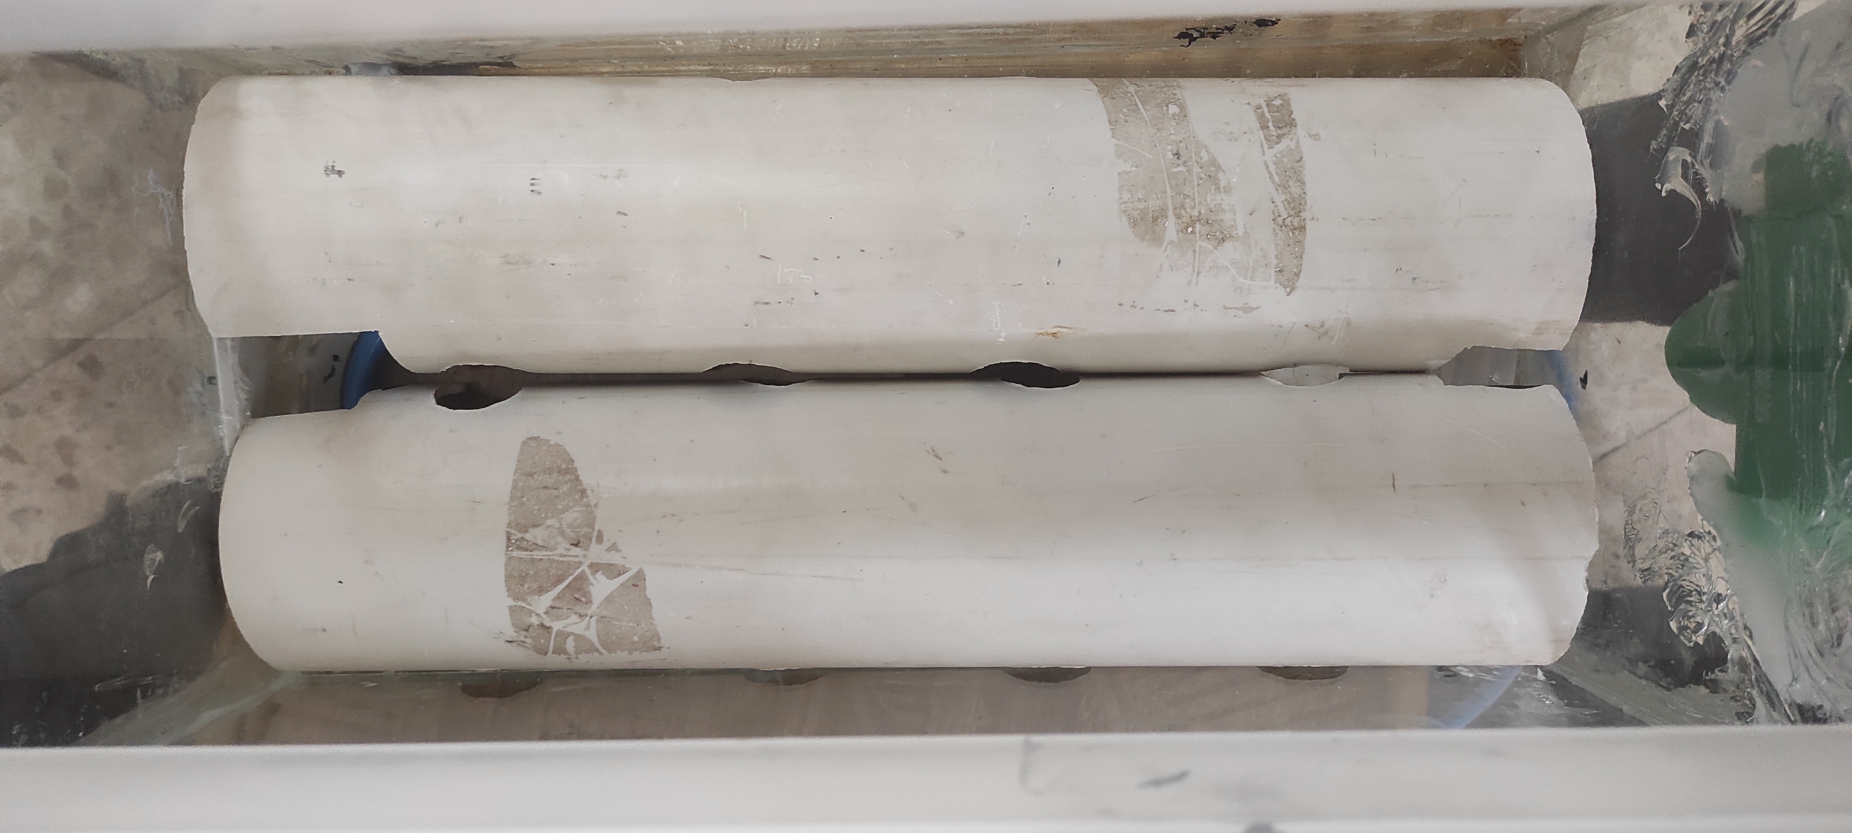
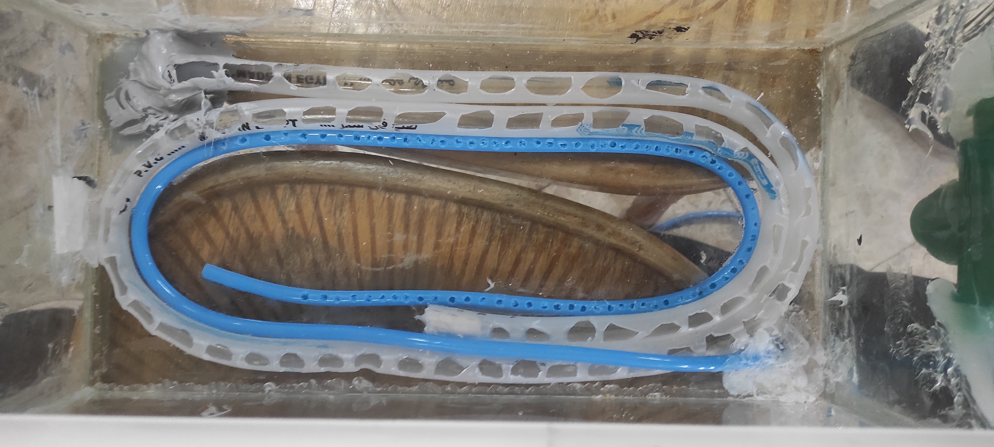
Perforated conduits
PVC blocks

Slide 33
Filtration
The next layer is a perforated fiber sheet that allows the water to flow through it but prevents the upper layers from falling apart.
Then comes the actual filtering layers from below we have three sizes of shingles ranging from lager ones in the bottom to smaller ones on the top and on top of those shingles a layer of sand is deployed in order to fill all the gaps in the shingles providing the best filtering results and a firm structure that filters and carries the water.

Slide 34
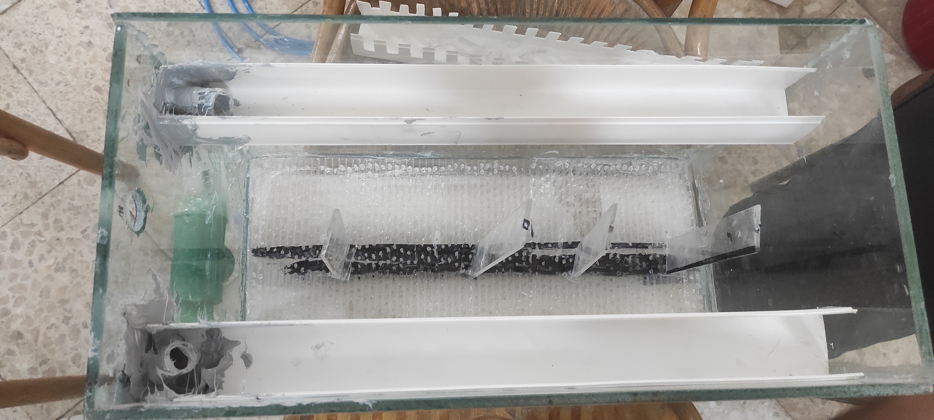
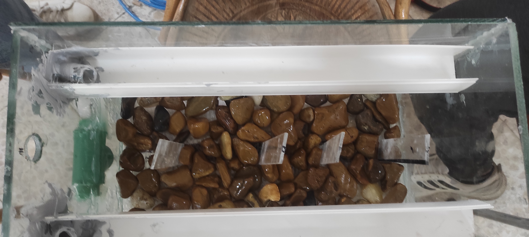
Perforated fiber
Lage shingles layer

Slide 35
Filtration
Right above the sand we installed a low-level water detection sensor that delivers the indication of the water’s arrival in the tank and a high-level water detection sensor that would start the reverse washing if the filters were blocked.
At the top of the filter, we installed PDS conduits designed to let the water fall in a distributed way so that it wouldn’t dig a hole in the sand and on both sides of the tank we installed conduits that would deliver the water to the sludge if the tank is being washed where both of them are merged into one pipe that drive the washing water to the sludge.

Slide 36
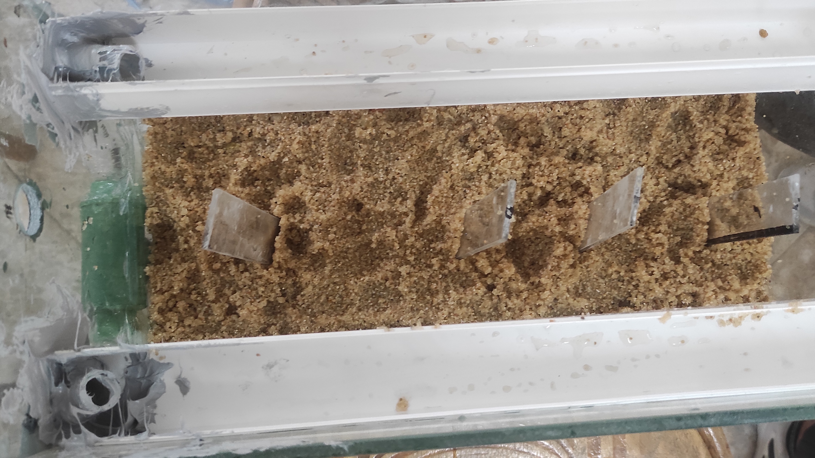
The final filter deployment

Slide 37
Washing the filter:
backwashing process to wash the filter at a specific time and with specific timers to distribute the washing with air and water Where air washing is used in the first third of the entire washing period Then the washing with water begins after the end of the first sixth of the washing period and continues until the end of the washing.
The values of these timers are determined by SCADA and converted from real values to a memory word that the PLC understands and vice versa, as happened previously in the clarifier.
After the end of the backwashing process, the sludge valve in the first filter is opened Also, after completion, a message appears on the SCADA for 10 seconds to restart the backwash, and if it is not approved within the 10 seconds, it turns into a non-restart.

Slide 38
The sludge tank:
The sludge tank collects all of the unneeded unclear water from either the clarifier or from the filters after they get washed.
The sludge tank has two sensors:
1- a low-level water detection sensor that indicates the arrival of water to the system.
2- a high-level water detection sensor that indicates that the sludge tank is almost full and as a result it must be emptied until the water reaches a level below the low-level water detection sensor.
To control the operation of the emptying of the tank a water valve and a water pump are needed.
1- the valve that opens when the water is at the level of the high-level sensor and closes when the water is below the low-level sensor which is all controlled by the PLC.
2- the water pump that would take the water away to the closest sanitation.

Slide 39
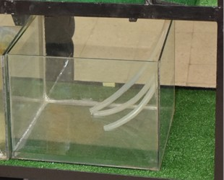
The sludge tank

Slide 40
The underground tank:
The final tank receives the clean water that comes from the filters directly.
The very same tank contains a water pump that is used to wash the filters since the water used to wash the filters reversely must be clean.

Slide 41
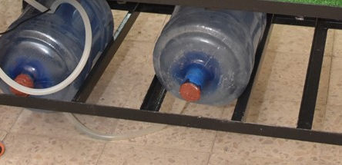
The underground tank:

Slide 42
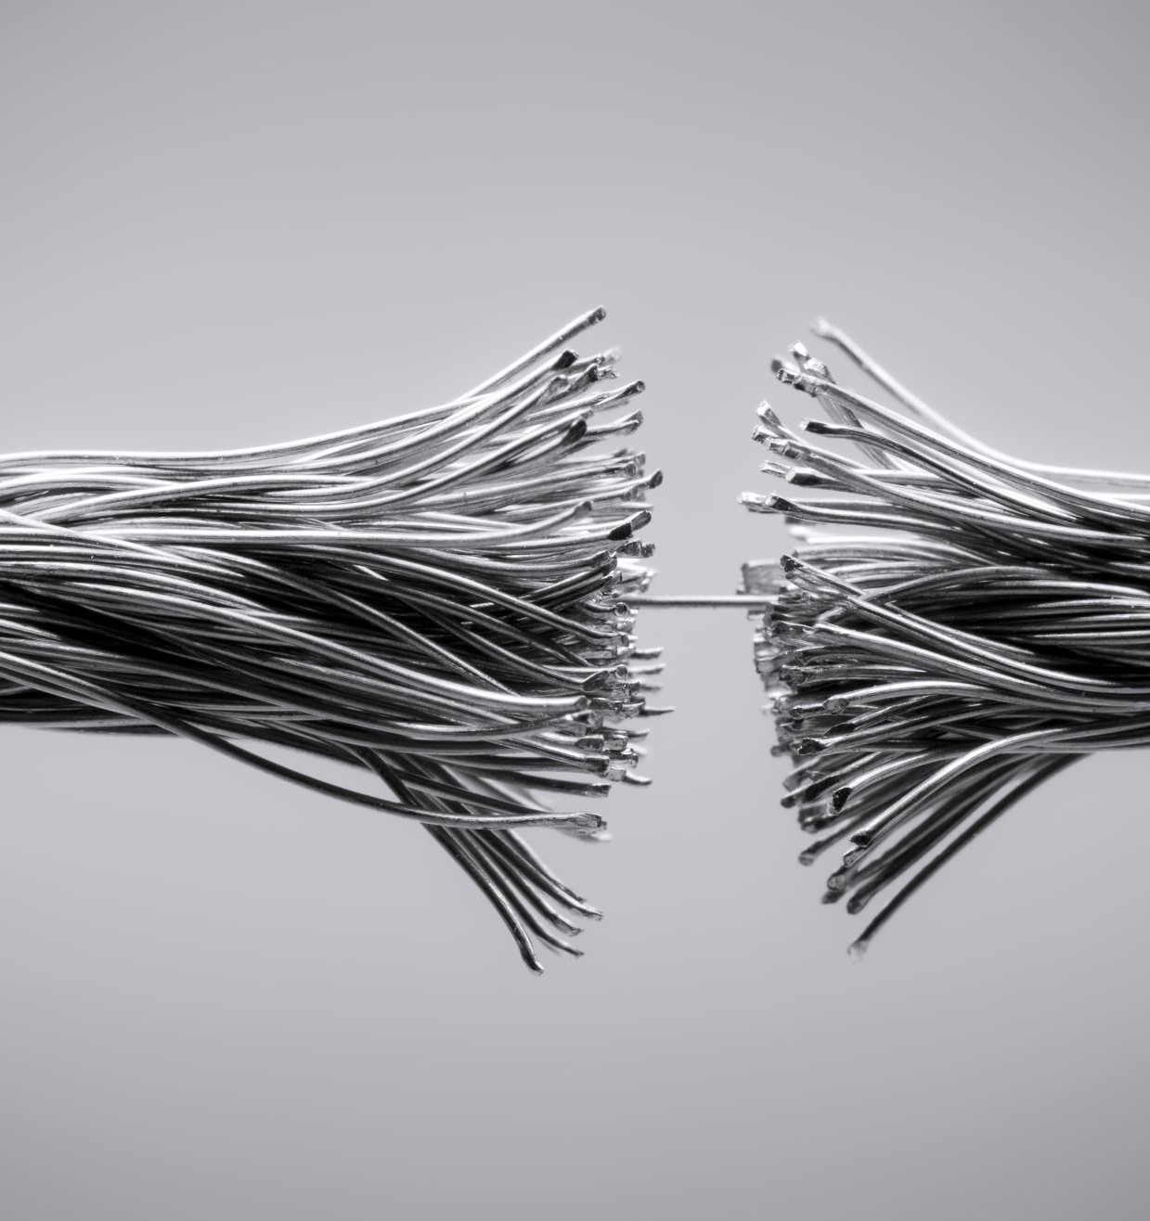
Electrical components

Slide 43
Electrical Components:
PLC
The MPI communication cable
Power supply:
relays:
Buttons and switches:
LED lights:
Water valves:
Water pumps
Arduino uno:
Water detection sensors
Motors
Siren
Air valves
Air compressor

Slide 44
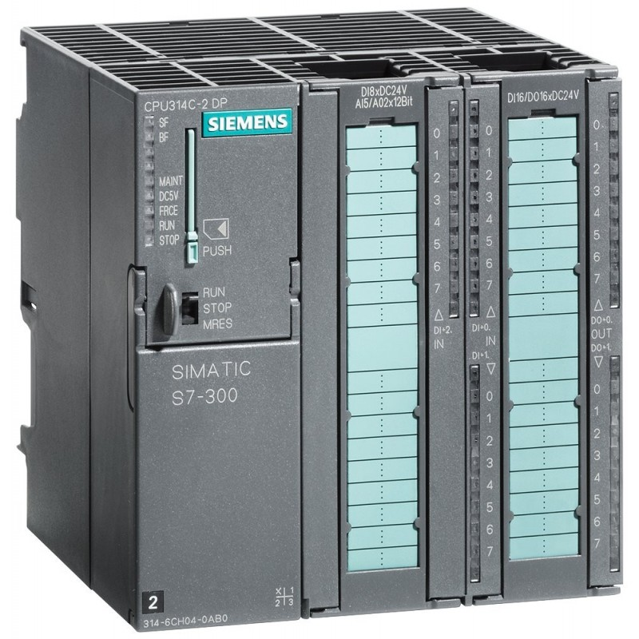
PLC
Let’s start with the most important component in the system, which is the PLC.
We used SIEMENS PLC 314C-2DP.
24 digital input – 16 digital output – 5 analog input – 2 analog outputs.
Operates on 24 DC voltage.
Contains a safety memory to protect the program loaded on it.
Contains two communication protocols:
MPI communication protocol which we used to connect the PLC to a computer.
Profibus which could be used for other communication purposes.

Slide 45
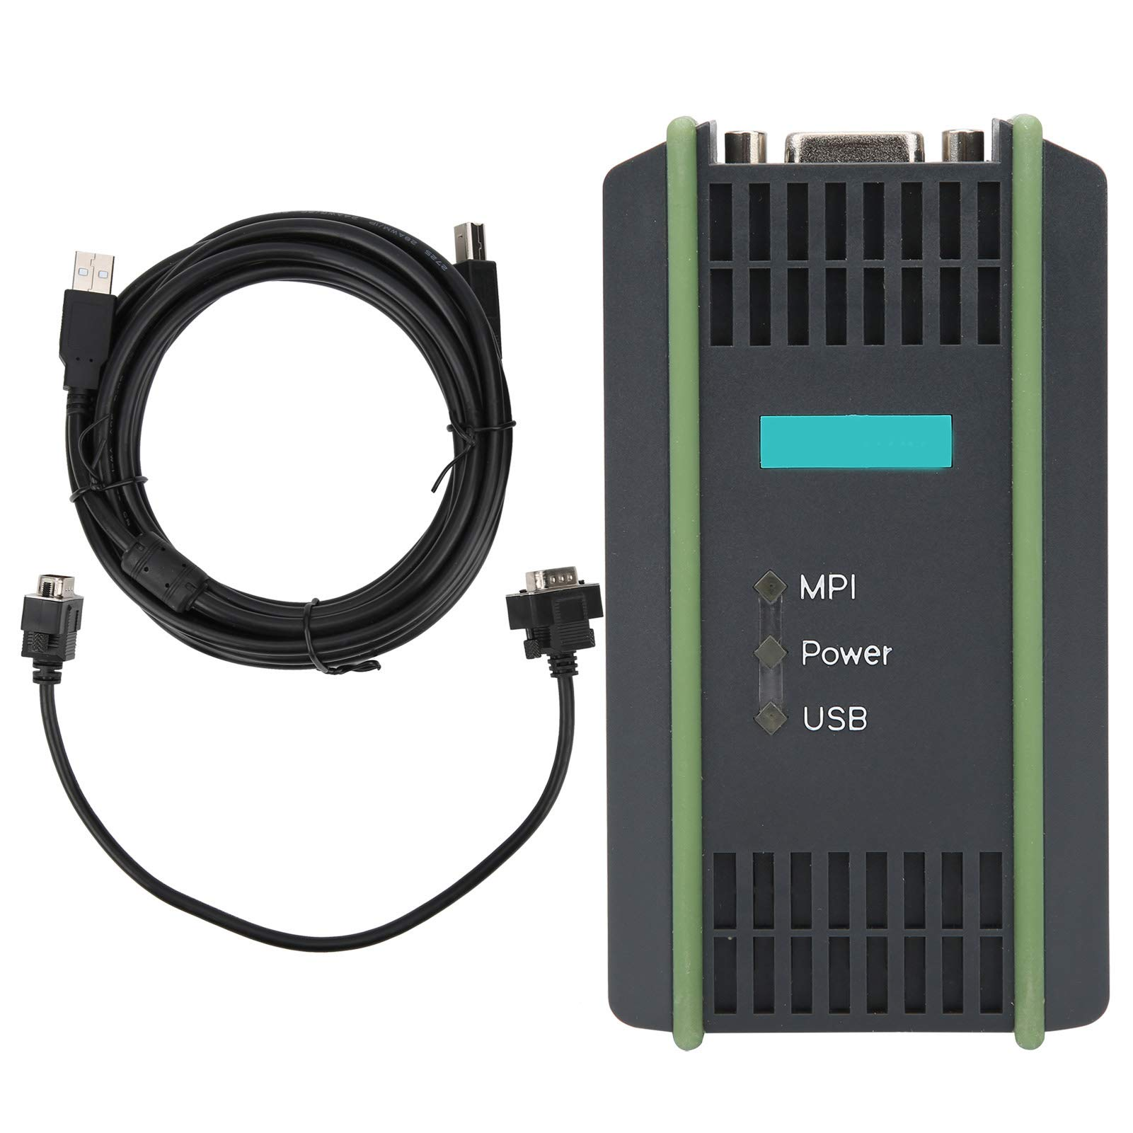
The MPI communication cable:
The MPI communication cable:
Which stands for Multi-Point Interface which is a proprietary interface of the programmable logic controller SIMATIC S7 of the company Siemens.

Slide 46
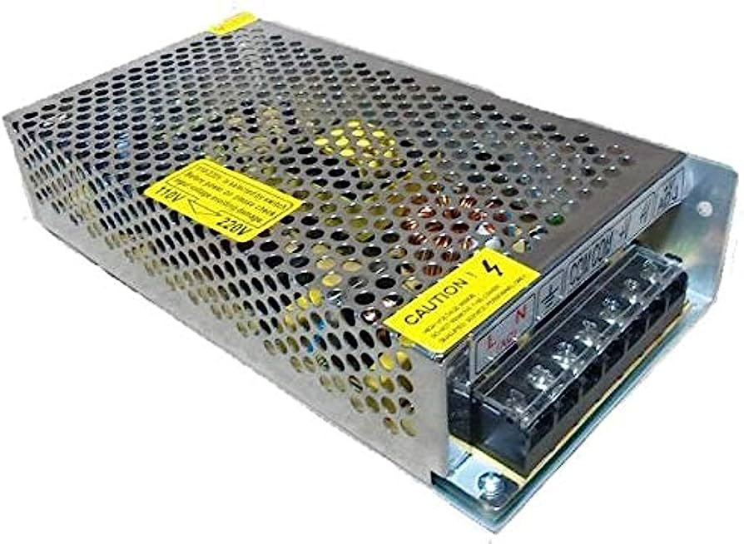
Power supply
It is a power supply that supplies 24 DC voltage after receiving 220 AC voltage so that it would supply the PLC and other 24-volt relays used.
It contains two supplying positive and negative points and line and neutral connections.
we used another power supply that supports 12 volts DC for the siren.

Slide 47
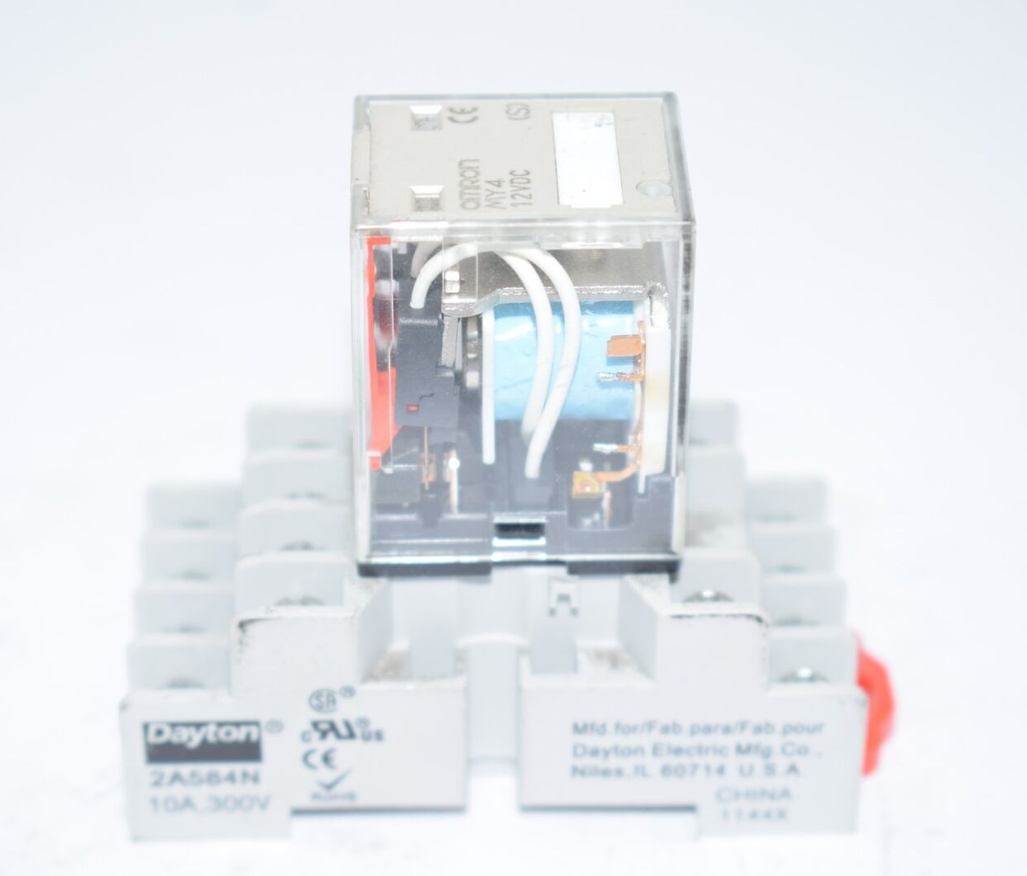
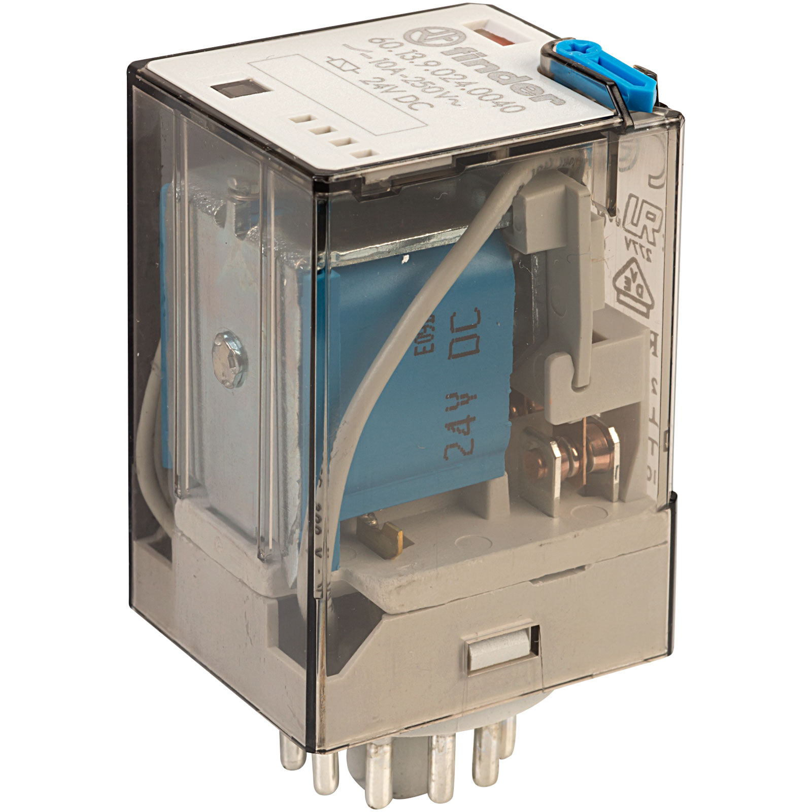
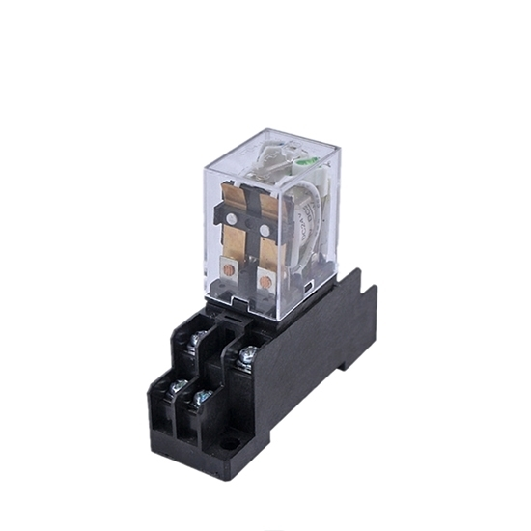
Relays
Relays are famous components in the field of industrial control, they are used as switches to control the actuators used in the system.
The used relays:
24-volt DC relays with 11 pin connection
24-volt DC relay with 8 pin connection
The following is a 220-volt AC relay with 11 pins
The following is a 220-volt AC relay with 14 pins

Slide 48
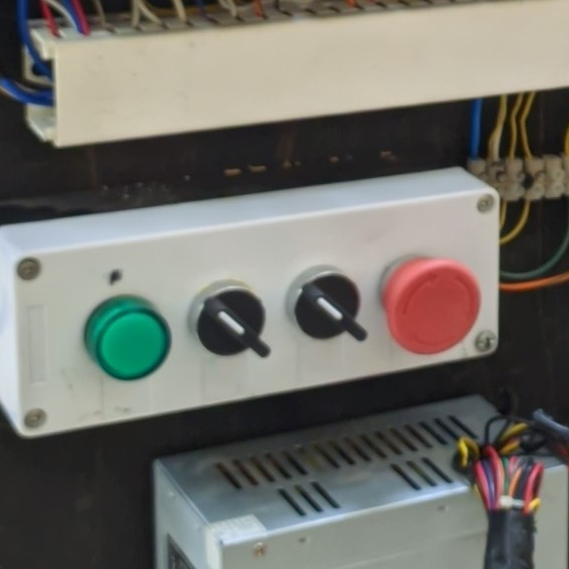
Buttons and switches:
on-off 220-volt AC switch
220-volt AC emergency switch

Slide 49
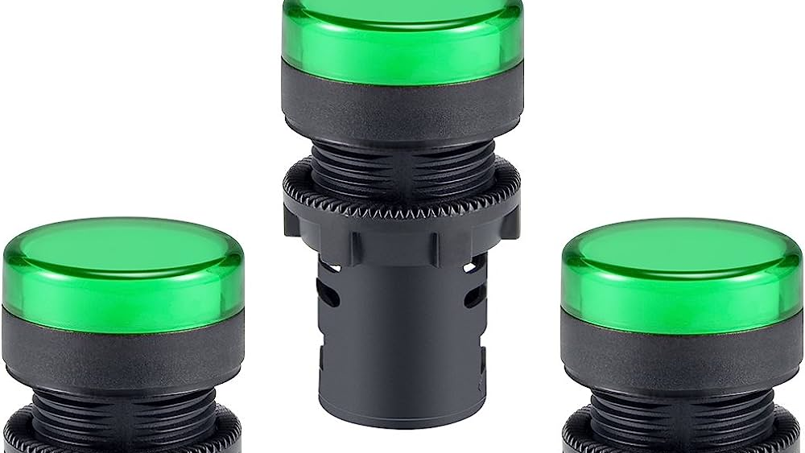
LED lights
1- green LED 220-volt AC light as shown above 2- LED 220-volt AC light strips.

Slide 50
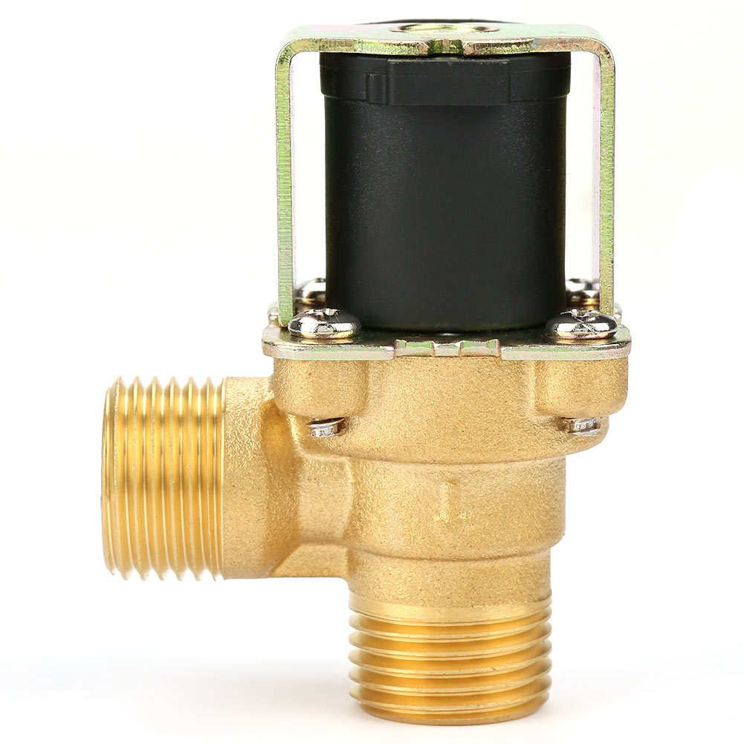
Water valves:
220-volt AC water valve

Slide 51
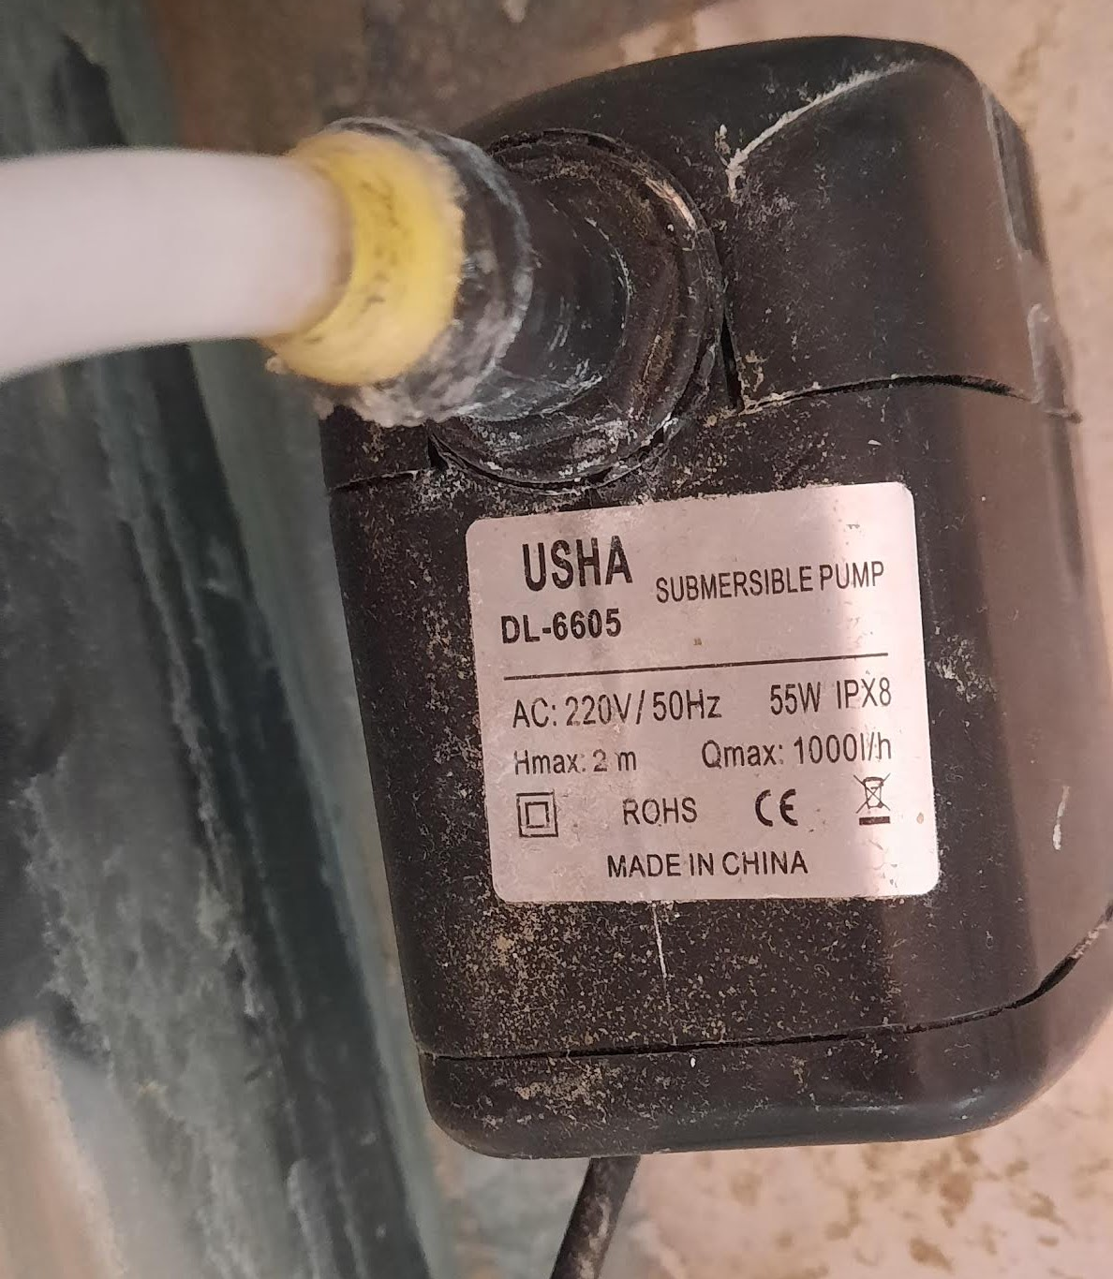
Water pumps
220-volt AC water pump
10 watt
H.max: 2m
Q.max: 1000/h

Slide 52
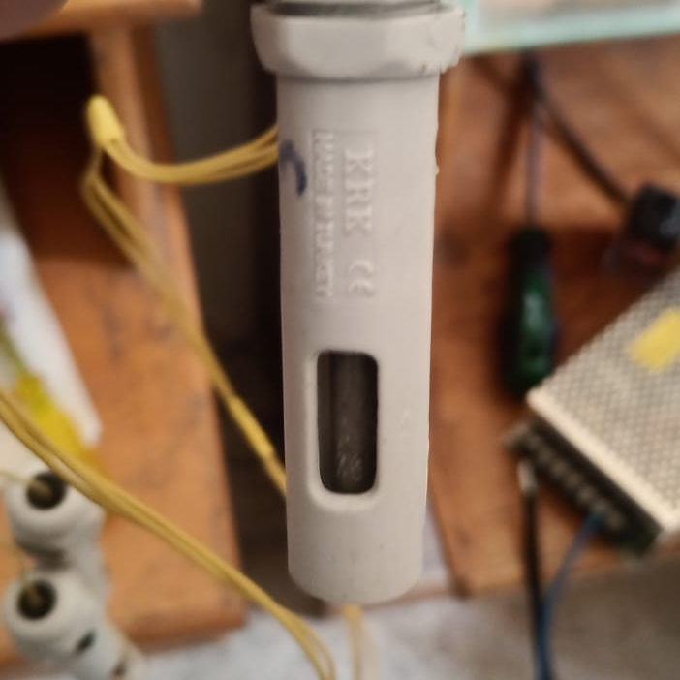
Water detection sensor

Slide 53
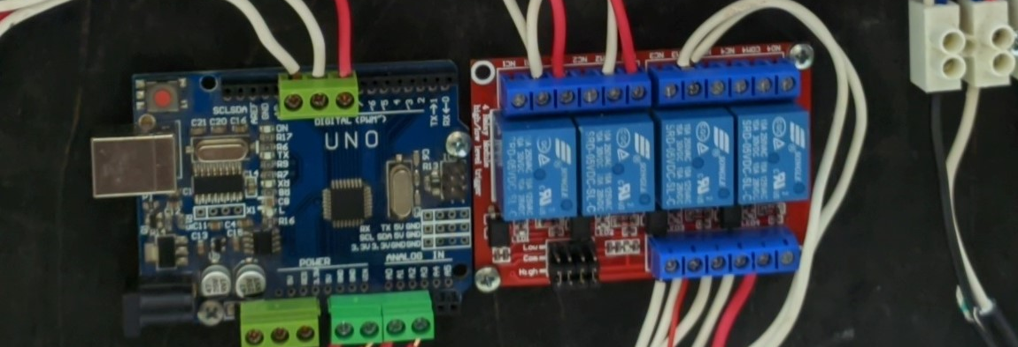
Arduino uno
Used in the ATS circuit

Slide 54
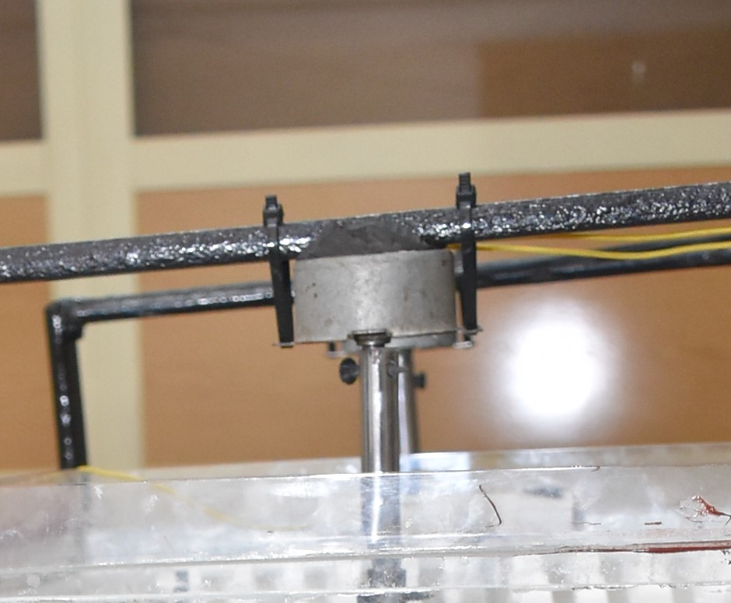
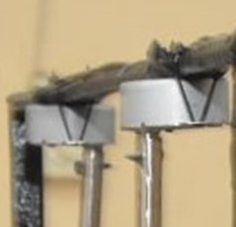
Motor
We used two motors:
1- Fast one for the flash mixer.
2- slower motor for the slow
mixer and clarifier.

Slide 55
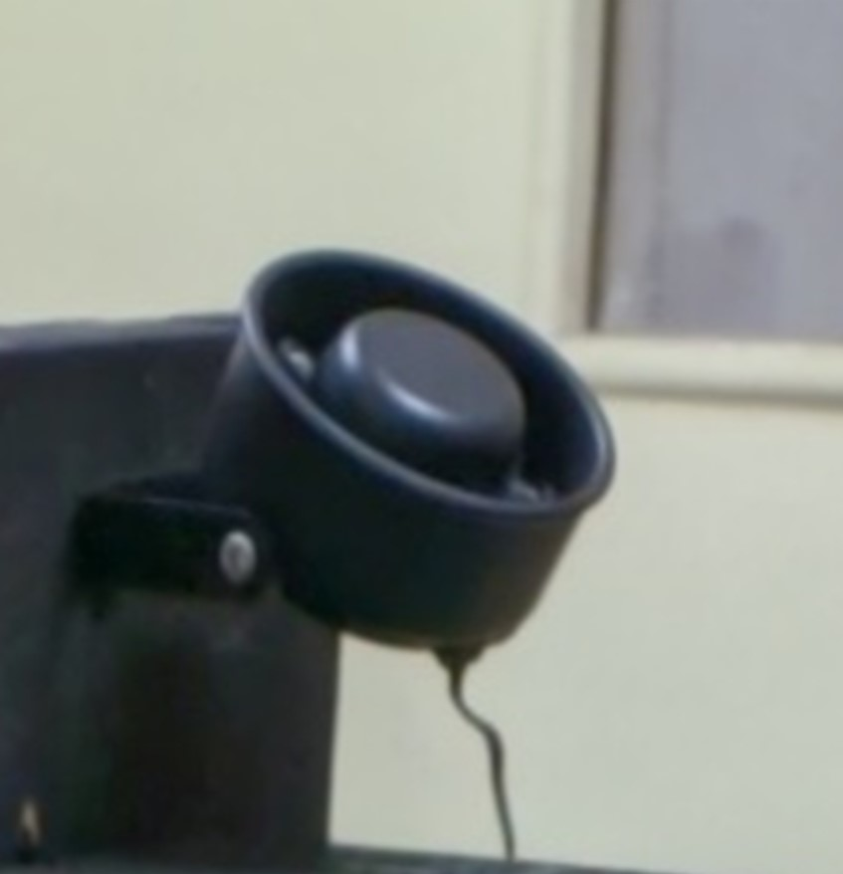
Siren
12 DC volt siren:

Slide 56
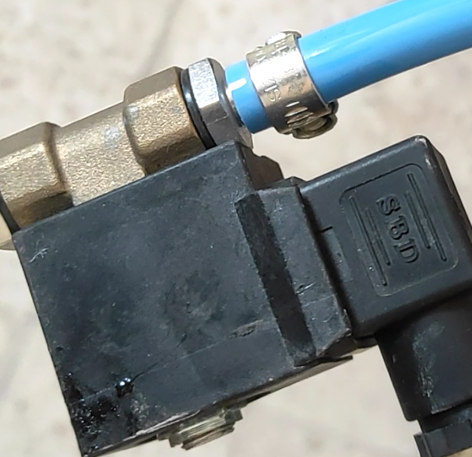
Air valve
220-volt AC air valve used to control the air flow

Slide 57
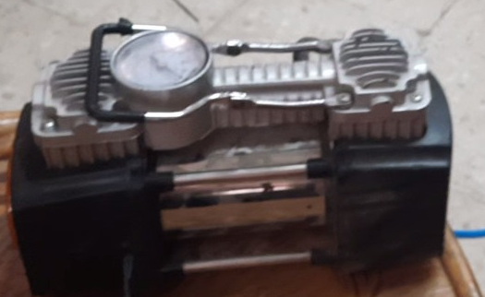
Air compressor

Slide 58
Software

Slide 59
Software utilized
1- Simatic manager step 7
used for developing the Ladder Diagram for the PLC
2-Wincc flexible 2008 SP5
used for developing the SCADA program
3-Eplan
used for drawing the system connections
4-Outseal
used for developing the Ladder Diagram for the Arduino chip

Slide 60
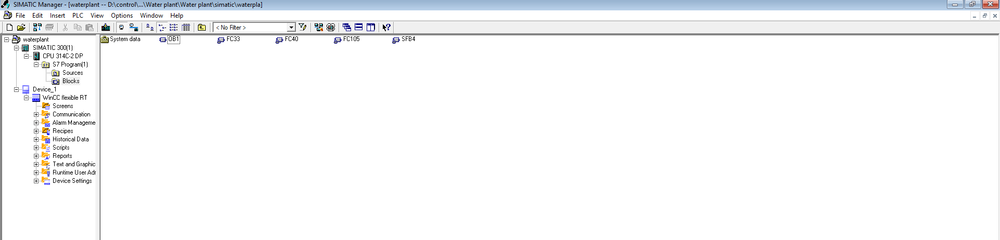
1.Simatic manager step 7
Blocks used in the project:

Slide 61
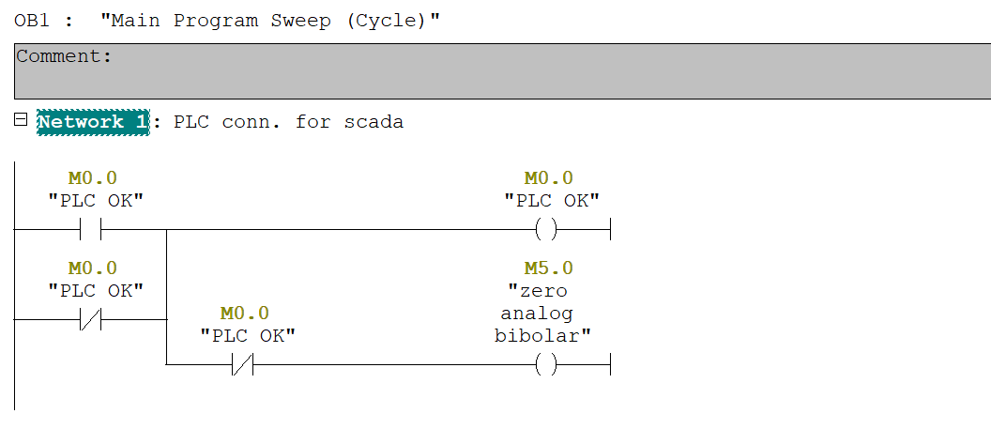
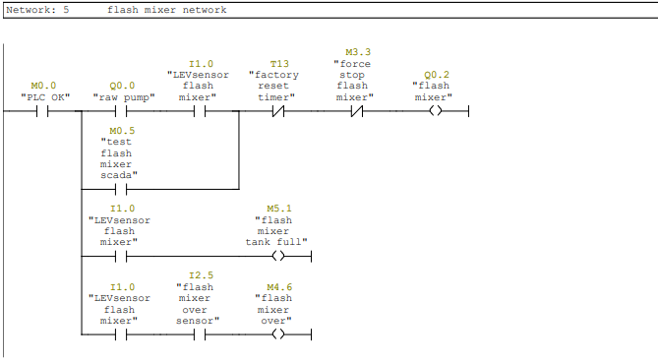
Networks used in the project:

Slide 62
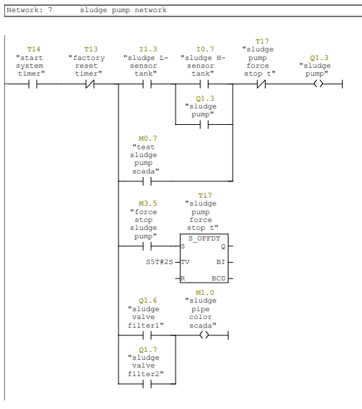
Networks used in the project:

Slide 63
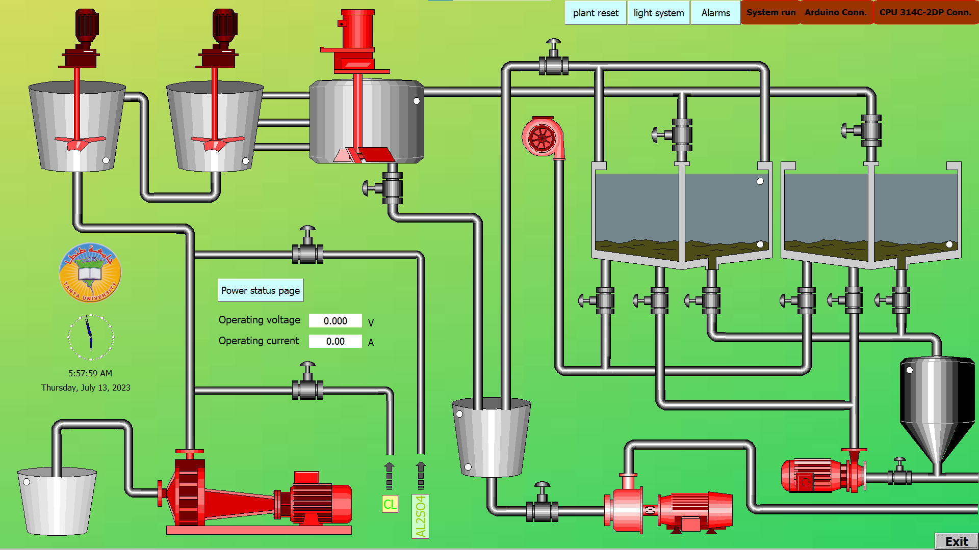
2-Wincc flexible 2008 SP5
Before PLC connection

Slide 64
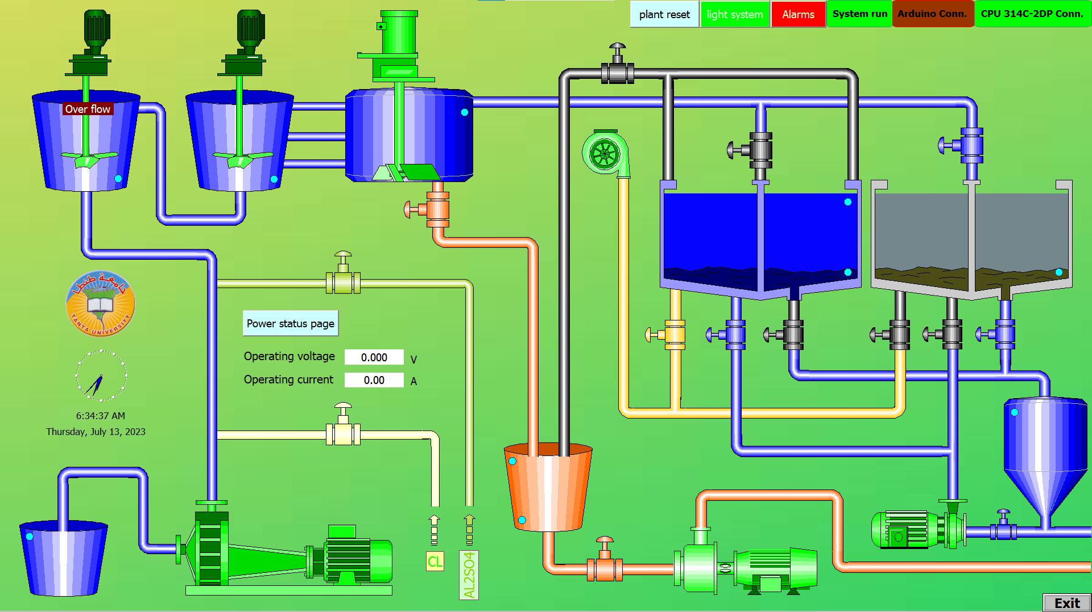
System after connection

Slide 65
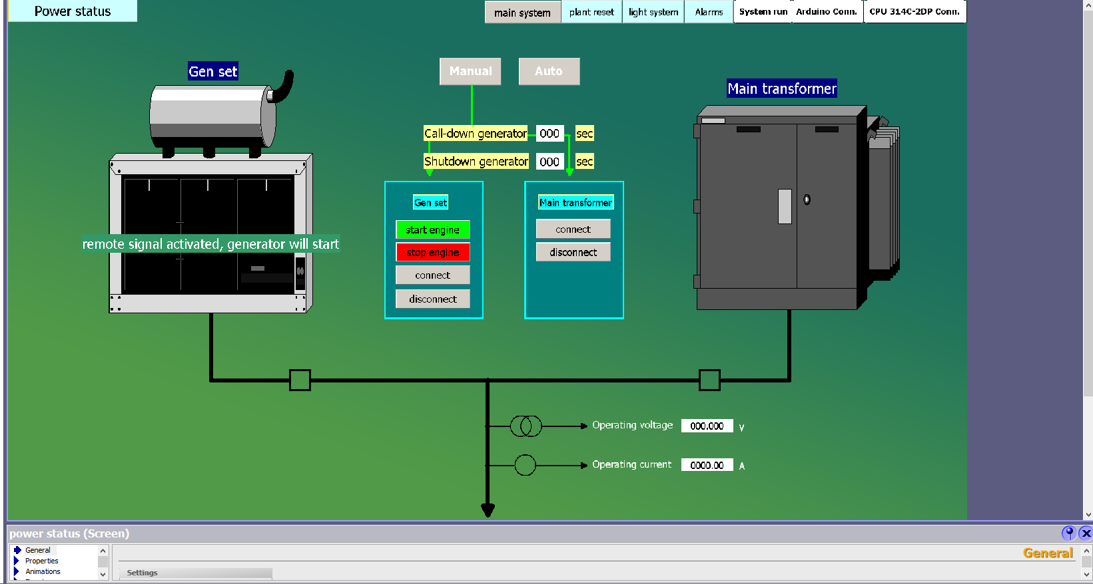
Alternative power supply

Slide 66
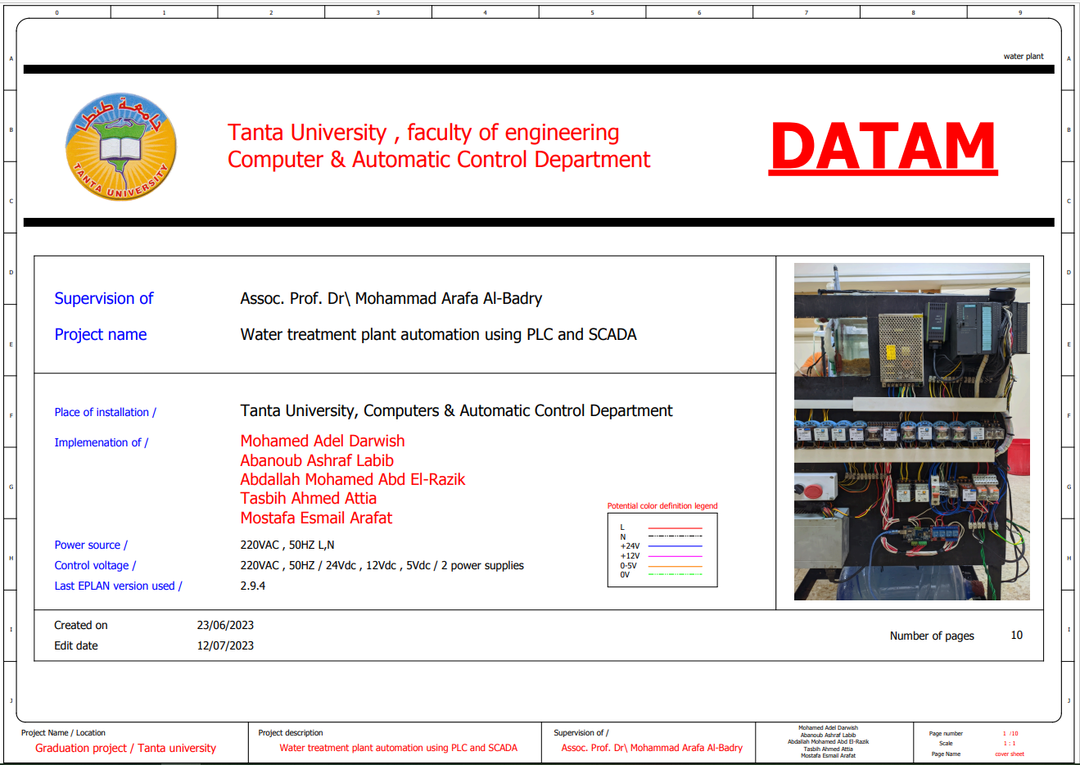
3-Eplan

Slide 67
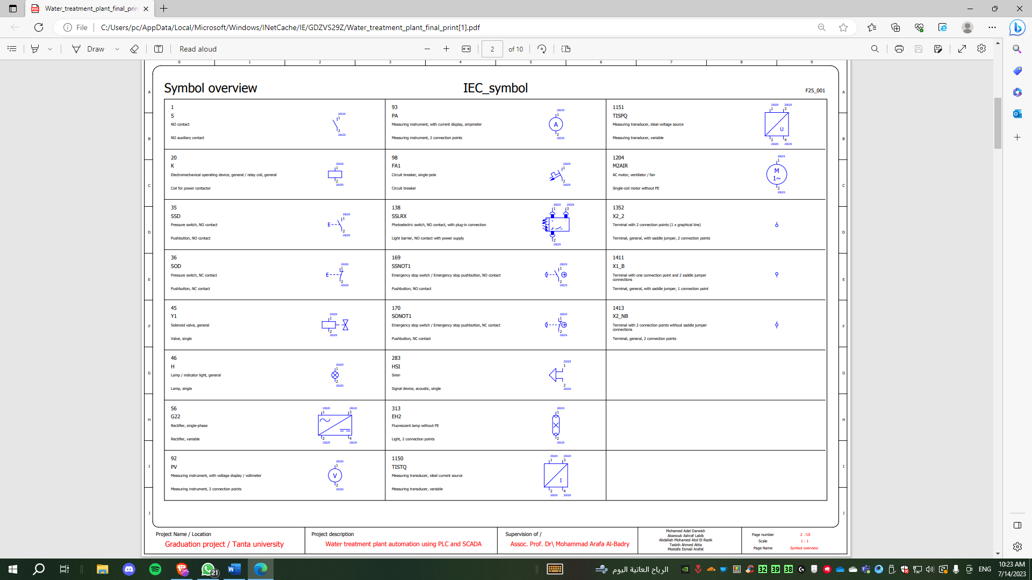

Slide 68
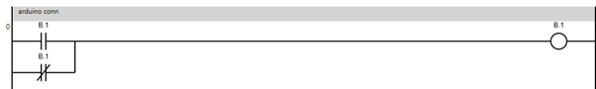
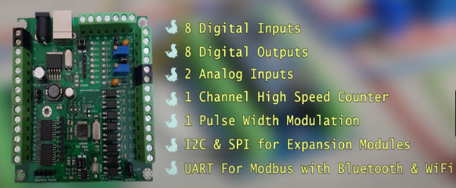
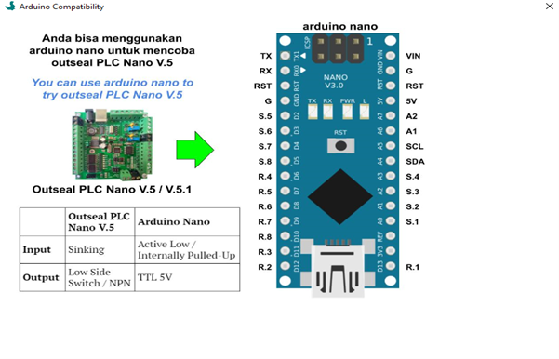
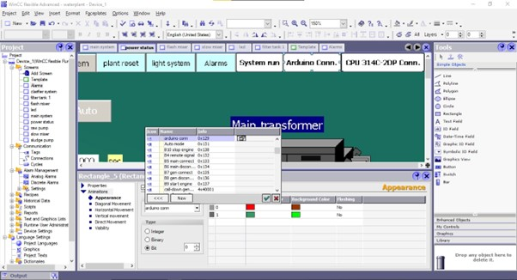
4-Outseal

Slide 69

ATS

Slide 70
ATS
What is an ATS (Automatic Transfer Switch)?
Low-voltage automatic transfer switch assemblies provide a reliable means of transferring essential load connections between primary and alternate sources of electrical power. Data centers, hospitals, factories, and a wide range of other facility types that require continuous or near-continuous uptime typically utilize an emergency (alternate) power source such as a generator or a backup utility feed when their normal (primary) power source becomes unavailable.

Slide 71
Types of ATS
1 out of 2
2 out of 3
2 out of 4

Slide 72
1 out of 2
Gen
Tr
CB2
CB1
L1

Slide 73
2 out of 3
Tr2
Tr1
CB2
CB3
CB1
L2
L1

Slide 74
2 out of 4
Gen
Tr2
Tr1
CB4
CB2
CB1
CB3
L1
L2

Slide 75
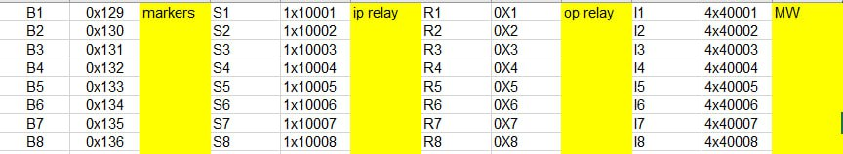
Modbus Addressing for Arduino

Slide 76
Modbus Types
Modbus RTU
Modbus ASCII
Modbus TCP/ip

Slide 77

ATS in SCADA system

Slide 78
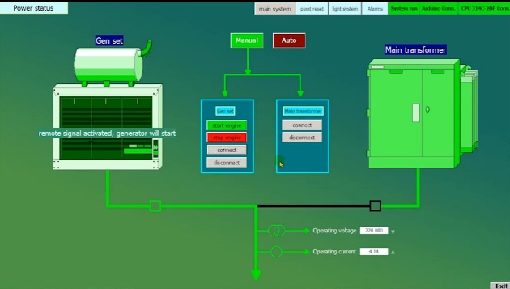
Manual mode:

Slide 79
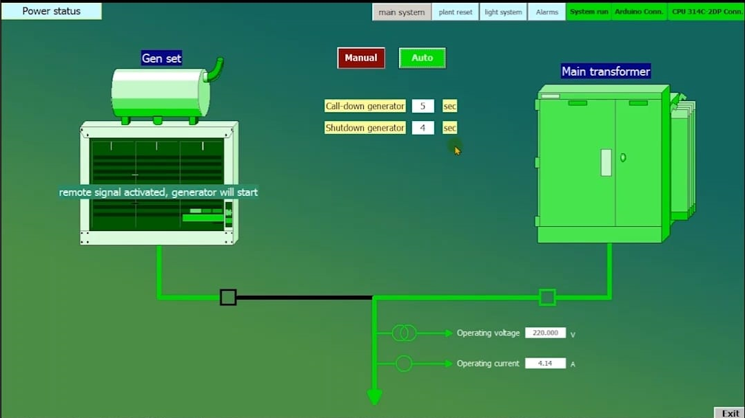
Automatic mode:

Slide 80
Future upgrades
1- mobile application control
2- AI powered flocculants control
3- SCADA network connection

Slide 81
Conclusion
By harnessing the power of Programmable Logic Controllers (PLCs), we have revolutionized the industry.
The main goal of our project was to deliver new technology and take new steps towards Scientific progress and delivering upgradable technology for generations to come.

Slide 82


